Slide 1

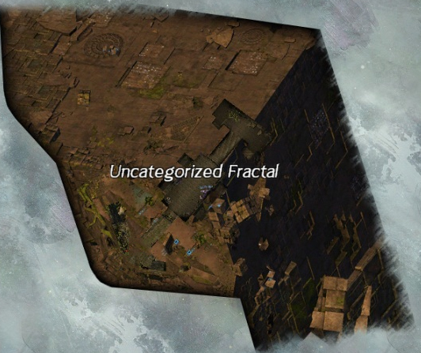
Uncategorized Fractal
Scales: 2, 36, 44, 62, 79, 91
By: Michie.4352

Slide 2
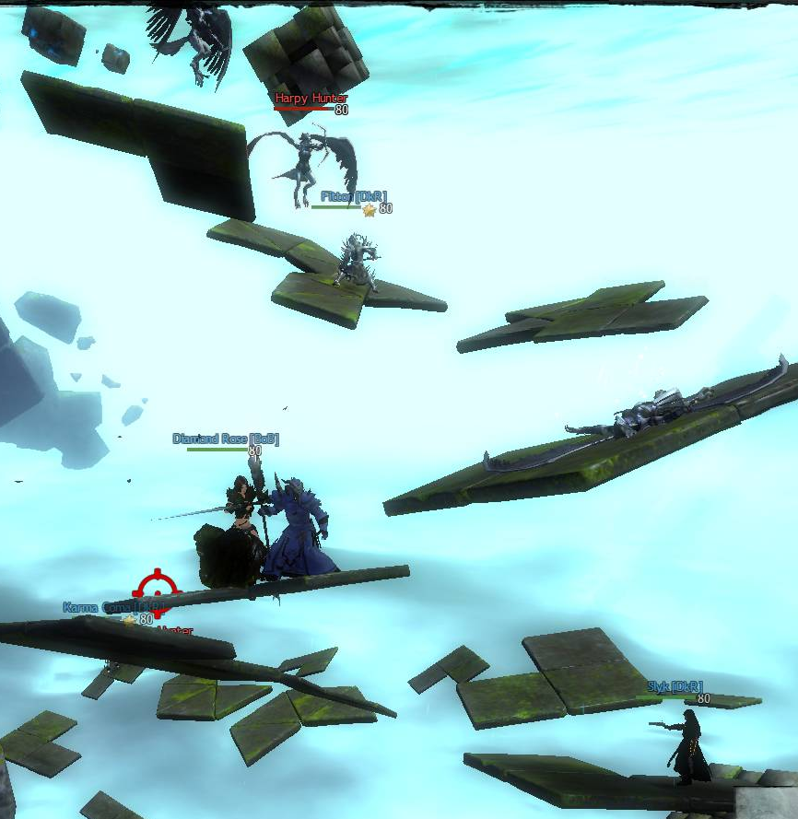
1. Jumping Puzzle (JP)
While jumping each platform, there are a few Harpies using their long range attacks
  Avoid their attacks! Otherwise, you won’t make the next jump…
There’s another skill that Harpies can use!
  It’s a red AOE that you’ll see on a platform that looks like static on the ground. If you see it, stay out of it! Once it activates and you’re in it, you will get knocked off the platform!
Advice: Kill all of the Harpies as you go up the JP
  Once you kill all of the Harpies, everyone will be able to use “/gg” to teleport to the top! It won’t make a difference if you have one teammate make it to the top if the Harpies aren’t all killed yet.

Slide 3
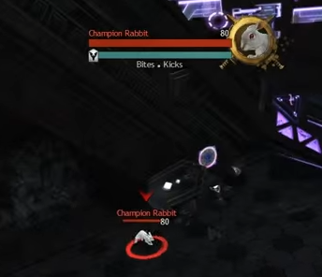
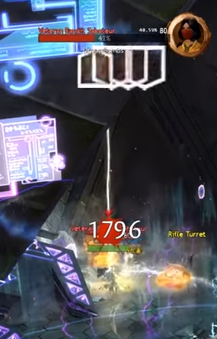
2. Mini Boss Fight – 4 to be Exact! Pt. 1
Best Strat: Kill the Bosses from Smallest to Largest!
  First Boss: Rabbit Champ
    Watch OUT for its ONE HIT K.O. – How? The Boss will come out first before the other Bosses come out so you should aim to skill the Rabbit Champ before the other three bosses gather together. There will be a CC (Blue) Bar at the very beginning. Use Fast CCs to stun the Champ and kill as fast as you can!
  Second Boss: Bandit
    Easy Kill with low health – If you have not finished killing the rabbit champ yet, lure both the Rabbit and the Bandit and kill them together

Slide 4
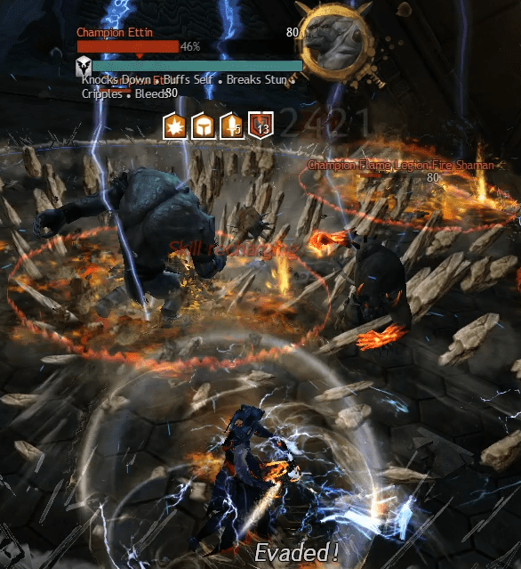
3. Mini Boss Fight – 4 to be Exact! Pt. 2
  Third Boss: Flame Legion Charr
    Watch OUT for Projectiles – How? When the Charr shoots out Fire Projectiles and it touches the ground, it creates a lava AOE that stays on the ground that stays for a while before it disappears. Stay out of those AOEs and kill. There will be CC bars popping up every so often that you can also utilize. For this boss, you can also use reflect against these projectiles!
  Last Boss: Ettin
    Watch out for its SMASH – How? When Ettin smashes the ground, he creates a large AOE that deals a lot of damage that can also knock you back. If you haven’t killed Charr yet, lure both Ettin and Charr together and cleave them as fast as possible.
Note: It’s a 5 Man Party! You should have a healer with you. Get used to stacking together with your healer to get boons and heals for more DPS!

Slide 5
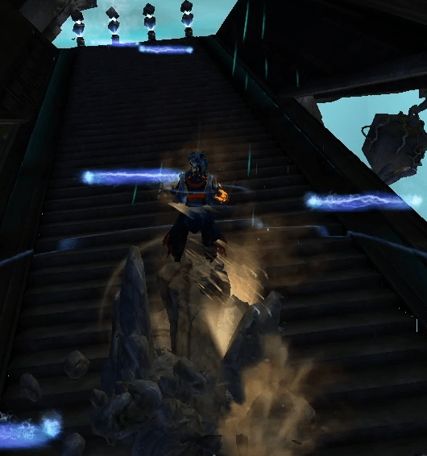
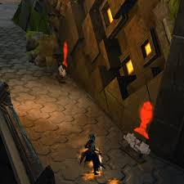
3. Mini Game – Laser Ramp
Just go up the Ramp!
  Oh right, there will be four different lasers randomly coming down the ramp. If you get hit by those lasers until your HP goes down, you will be teleported to the bottom of the ramp again.
Should be Easy Enough! I think.. There’s more though!
  Once you make it to the top, you will need to interact with three different panels at the same time to stop the lasers from popping out. So, you’ll need three of your teammate to get to the top to interact with them.
Best Strat: Get to the top without getting hit by those lasers. You can side step, dodge, block, reflect, invuln., or port up. Best way is if your support has a reflect bubble. You may want to watch out for which bubble you use because it can bounce up the ramp instead. In which case, you’ll be getting hit both ways!
  If you have a Mesmer, you can use your portal to use two panels at the same time and end up only needing 2 of your teammates to make it up there.

Slide 6
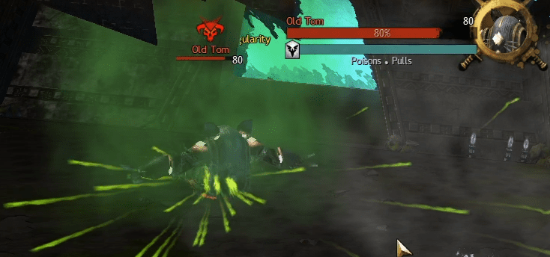
4. Mini Boss – Old Tom (Golem)
Two Mechanics you need to watch out for:
  Spinning while Spewing out Poison
  Spins can pull a player in
How to Kill it?
  Best Strat: There will be a CC bar that pops up pretty often. Look out for it and use your Fast CC skills to stop the Golem from using its skills. Once you CC, the CC bar will load back up until the Blue bar pops up again. In between those CCs, you’ll want to deal as much damage as possible before the Golem gets out of its daze.

Slide 7
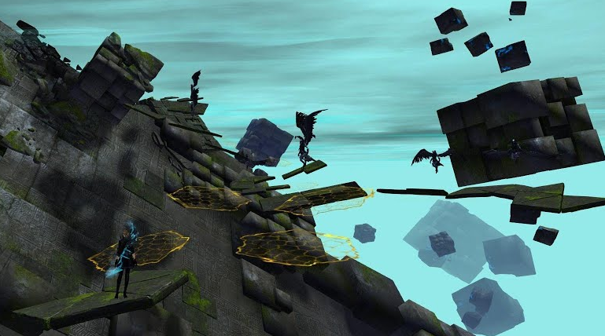
5. 2nd Jumping Puzzle
This one is similar to the first Jumping Puzzle
  You’ll have Harpies with their long range attacks but this time when it hits you, you will be able to still make the next jump.
  Some platforms will look different – A much brighter color that you may not be able to see normally. You’ll want to angle your screen so that you are looking at the top of your character’s head.
  Good News: Once one of you in your party makes it to the end of the jumping puzzle, the rest of your team will be able to type in “/gg” and teleport to the end of the jumping puzzle!

Slide 8
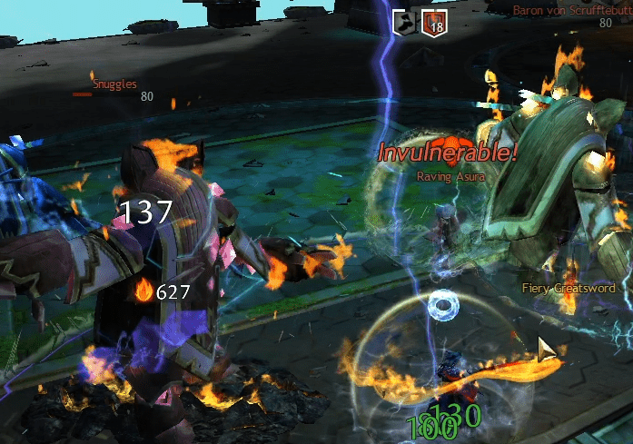
6. Final Boss – 4 Cat Golems
There will be 4 CAT GOLEMS, which you can hear them “Meow” every time you hit them ☺
  Once you go in, you will have to kill one Cat Golem at a time until the last Golem. Then all 4 Cat Golems will come up again for you to kill. Each Golem has one mechanic different from the other!
Watch out for the Asura in the Middle!
  You can’t DPS the Asura because it’s invuln. But it can attack us. The Asura has long range attacks which is best for you to avoid because those attacks can cause daze, debuff, and/or small amount of damage with orbs
Best Strat: Save your AOEs to kill all four golems together but it’s totally fine to kill them one at a time. Avoid the Asura while killing the Cat Golems. You can use reflect to have it bounce back.

Slide 9
Good Luck
If you have Questions, Feel Free to DM me!

